Slide 1

NES
A tech talk by eddie

Slide 2
Rough plan
Why?
CPU
  Counters, Pointers & Registers
  Opcodes
  First working program
  Testing
BUS
RAM
NES Cartridges
PPU
  Registers & Behaviour
  Palettes
  Scrolling
APU
  Registers & Channels
Testing hell

Slide 3
Motivation
Computers seem like magic, I want to learn how they actually work at the lowest level
I prefer to learn by doing, so I want to pick a reasonably simple architecture to emulate
I like gaming
NES seems like a good fit for these
  There’s plenty of tutorials online
  I can learn a new language (Rust) while I’m at it
I like a challenge
It’ll be fun! (maybe)

Slide 4
Before we start...
Computers do arithmetic, and there’s lots of numbers flying around.
It’s standard practice to write numbers in hexadecimal (base 16)
  Use numbers 0, 1, … 9 as usual, and then A = 10, B = 11, C = 12, D = 13, E = 14, F = 15
  Numbers written in hexadecimal will be prefixed with “0x”
Sometimes it’s easier to think of the bits when dealing with bit-flags, so the number will be written in binary (base 2)
  Numbers written in binary will be prefixed with “0b”
e.g.
  231 = 0xE7 = 0b11100111

Slide 5
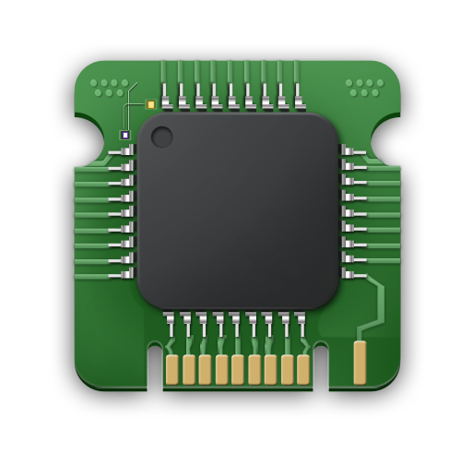





How to build a NES
CPU
PPU
RAM
APU
BUS
CONTROLLER

Slide 6
The CPU
The NES CPU is based on the MOS 6502 8-bit microprocessor.
  “based on” => For all intents and purposes, treat as the same. There’s a few things that aren’t used in NES, such as floating point arithmetic. (TODO – FACT CHECK)
The MOS 6502:
  Has an 8-bit data width (registers are 8 bits)
  Addresses with 16 bits
  Uses the MOS 6502 instruction set
  Was a commercially successful processor: It was used in Apple I, Apple II, numerous Atari consoles (2600, 5200, 7800) and many more devices.

Slide 7
How does a CPU work?
TODO: In own words, with some diagrams!
Here’s a concise, general overview of how a CPU works:
A CPU operates in a fetch–decode–execute cycle, repeatedly reading an instruction from memory, interpreting what it means, and then carrying it out.
The program counter (PC) tracks where the next instruction lives in memory, advancing (or jumping) as instructions are executed.
During execution, the CPU uses registers (small, fast storage locations) to hold data, addresses, and intermediate results.
An arithmetic logic unit (ALU) performs calculations and logical operations, updating status flags based on the result.
A control unit coordinates all of this, deciding which components act at each step and how data moves between them.
In short, a CPU is a tightly choreographed loop of moving data, performing operations, and deciding what to do next—millions or billions of times per second.

Slide 8
6502 Architecture - Registers
Name | Symbol | Size (bits) | Purpose
Accumulator | A | 8 | Central register used to perform arithmetic, logic, and data transfer operations directly on values
X | X | 8 | Primarily used for indexing memory addresses, looping, and counting in operations like array access and iteration
Y | Y | 8 | Same as X
Status | P | 8 | Holds flags that indicate the results of operations and control certain processor behaviours
Program Counter | PC | 16 | Holds the address of the next instruction to be fetched and executed, controlling the flow of the program
Stack Pointer | S | 8 | Holds the address of the top of the stack in memory, managing temporary storage for return addresses, processor status, and local data

Slide 9
6502 Opcodes
The 6502 processor has 56 official instructions
  Simple example: STA (Store accumulator)
    Stores the current value of the accumulator in a specified memory address
Each instruction has one or more addressing modes
  Instruction + Addressing Mode <=> Opcode
  E.g. for STA:
    0x85: STA with “Zero Page” addressing mode
    0x8D: STA with “Absolute” addressing mode
Combining these results in 151 official opcodes
But an opcode is byte – what about the remaining 256 – 151 = 105 opcodes?
  They still “work” on the hardware. They are unofficial opcodes.
    e.g. TOP (Triple No Op), 0x0C (addressing mode Absolute)
So, there’s 256 opcodes to implement…
  Luckily there’s quite a lot of common logic that makes this less tedious (but still tedious)

Slide 10
6502 Addressing Modes
Name | Description | Example
Accumulator | Instruction acts directly on the Accumulator | ROR – Rotate bits right. A → A >> 1
Immediate | Constant value. | LDA #10. Load 0x10 directly into A
Relative | Relative to current program counter | BEQ +10. Skip next 10 bytes
ZeroPage | Zero page address | LDA $10. Load value at 0x0010 into A
ZeroPage_X | Zero page address + X | LDA $10,X. E.g. if X = 0x01, load memory from 0x0010 + 0x0001 = 0x0011
ZeroPage_Y | Zero page address + Y | LDA $10,Y. Similar to above
Absolute | Full 16 bit address | LDA $1234. Load value at 0x1234 into A
Absolute_X | Full 16 bit address + X | LDA $1234, X. E.g. if X = 0x02, load memory from 0x1234 + 0x0002 = 0x1236
Absolute_Y | Full 16 bit address + Y | LDA $1234, Y. Similar to above
Indirect | Full 16 bit address which identifies the actual address for the instruction | JMP ($1234). Read from 0x1234 (low byte) and 0x1235 (high byte). Use these to form new address: 0x7890, say. Then target is 0x7890, so jump to 0x7890.
Indirect_X | Specifies a zero page address “D”. Compute E = D + X. Then the actual address is read from E. | LDA ($10, X). E.g. if X = 0x02. Compute 0x10 + 0x02 = 0x12. Then read from 0x12 (low byte) and 0x13 (high byte) to get the target address.
Indirect_Y | Specifies a zero page address “D”. Read a 16 bit address “E” from this. Then read E + Y to get the actual 16 bit address. | LDA ($10), Y. E.g. if Y = 0x02. Load low and high bytes from 0x10 & 0x11 to form a new address, 0x4321 say. Then add Y to get target address 0x4323.

Slide 11
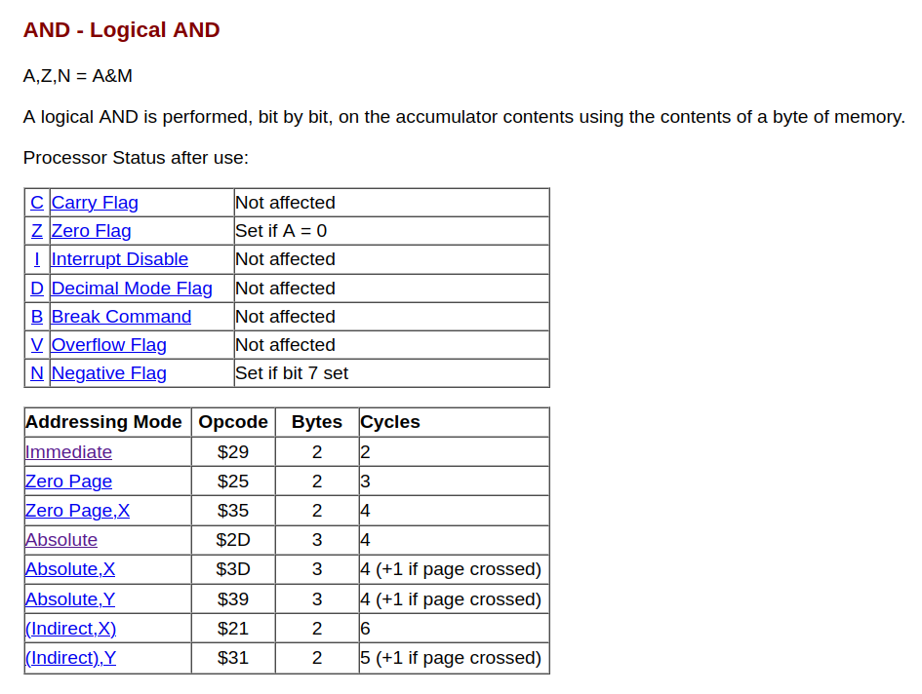
Example Opcode: AND
Read a value M
Compute A & M
Store value in A
Update status flags
Schema wording threw me: “Set if A = 0” actually means:
if A == 0: set ZERO_FLAG
else: unset ZERO_FLAG
(and similarly for negative flag)

Slide 12
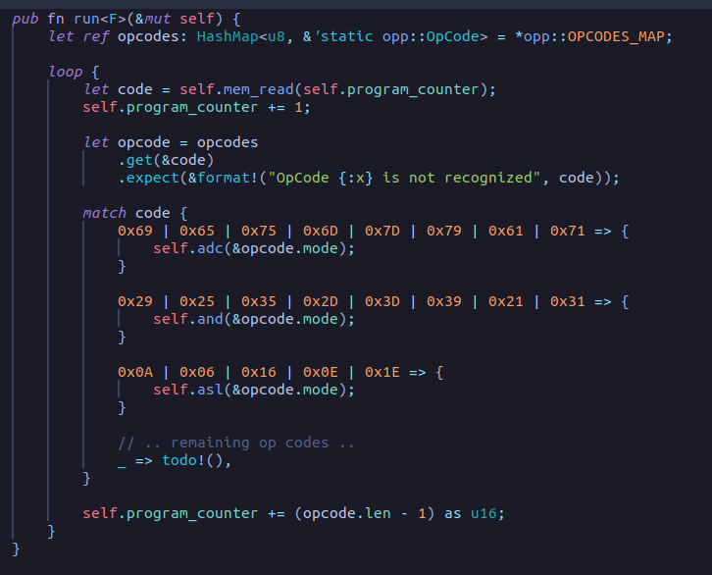
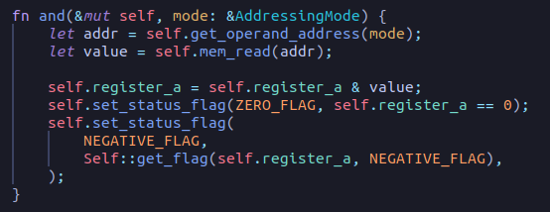
Emulating the CPU

Slide 13
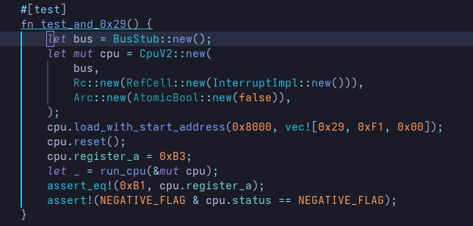
Testing the CPU
Many unit tests for each operation:

Slide 14
Tracing
Now that we have a working CPU, it will be useful to add some tools to see what it is actually doing.
Standard approach used by many emulators is to print a trace for each line of CPU execution.

Slide 15
Tracing
c625015 C17E 40 RTI A:01 X:12 Y:00 P:24 SP:FC
c625021 C256 D0 FC BNE $C254 A:01 X:12 Y:00 P:25 SP:FF
c625024 C254 A5 40 LDA $40 = 00 A:01 X:12 Y:00 P:25 SP:FF
c625027 C256 D0 FC BNE $C254 A:00 X:12 Y:00 P:27 SP:FF
c625029 C258 A4 3F LDY $3F = 00 A:00 X:12 Y:00 P:27 SP:FF
c625032 C25A B9 67 C2 LDA $C267,Y @ C267 = 7A A:00 X:12 Y:00 P:27 SP:FF
c625036 C25D 85 10 STA $10 = 7A A:7A X:12 Y:00 P:25 SP:FF
c625039 C25F B9 68 C2 LDA $C268,Y @ C268 = C2 A:7A X:12 Y:00 P:25 SP:FF

Slide 16
Test ROMs

Slide 17
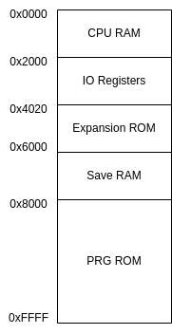
6502 Architecture – Memory Layout

Slide 18
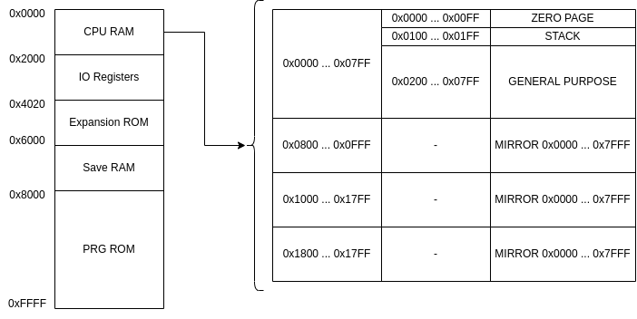
6502 Architecture – Memory Layout

Slide 19
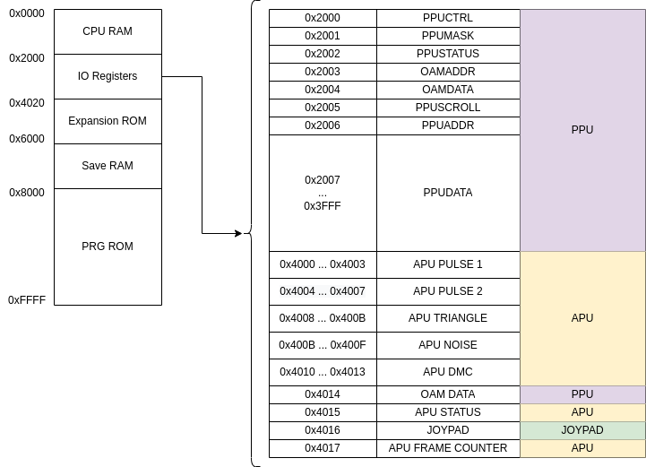
6502 Architecture – Memory Layout

Slide 20
Implementing RAM + BUS

Slide 21
The PPU

Slide 22
Ticking

Slide 23
More Test ROMs

Slide 24
The APU

Slide 25
More Test ROMs

Slide 26
Demo

Slide 27
Questions?

